Slide 1

Travel and Tourism Management System
NAME: PINNINTI THANUJA
R0LL NUMBER: 130523862036 COURSE: MCA(A)

Slide 2

Index
Introduction
System Architecture
Functional Modules
Database Schema
ER diagram
Testing Process and Testing case Results
Conclusion
Future Enhancement

Slide 3

1.Introduction
What is the Travel and Tourism Management System?
A software solution that automates travel bookings, customer management, and payment processes.
Users (customers) can book hotels and tour packages.
Admins can manage customers, packages, destinations, and bookings.
Why is this system needed?
Traditional travel booking methods are time-consuming and inefficient.
Users need a one-stop solution to book travel services conveniently.
Secure and seamless payment processing is required.
Key Objectives: ✅ Provide a user-friendly travel booking experience. ✅ Manage customer records efficiently. ✅ Automate payments and confirmations. ✅ Ensure security and reliability in transactions.

Slide 4

Overview of Architecture
Frontend: Java (Swing/AWT) for UI
Backend: Java (JDBC for database interaction)
Database: MySQL
Payment Gateway: Paytm API for payment processing (online)
How Components Interact?
User logs in → Customer details → Books package/hotel → Makes payment → Receives confirmation.
Admin can manage customer details, bookings, payments, and packages.
2.System Architecture

Slide 5

3.Functional Modules
The system consists of five core modules:
1️⃣ User Management
Signup/Login
Forgot Password
2️⃣ Package & Destination Management
Admin can add, view, update, or delete travel packages.
Users can browse different destinations.
3️⃣ Booking System
Users can book hotels and packages.
Booking confirmation through view details.
4️⃣ Payment Processing
Paytm payment integration for seamless transactions.
5️⃣ Customer & Booking Management
Admin can view all customer details.
Users can check their bookings and print tickets.

Slide 6
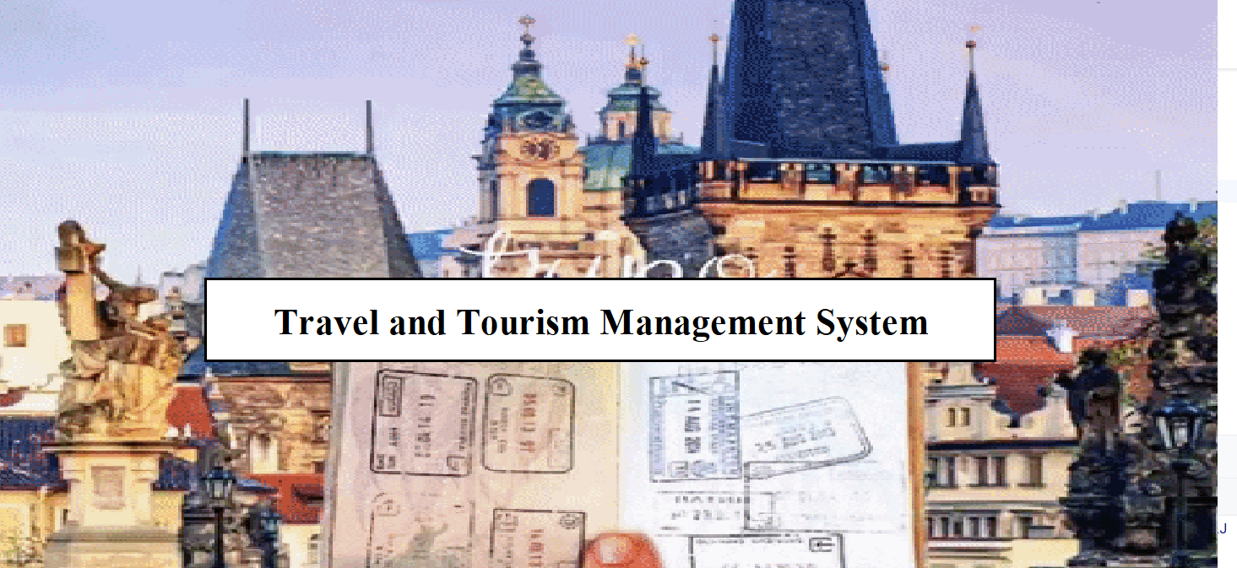
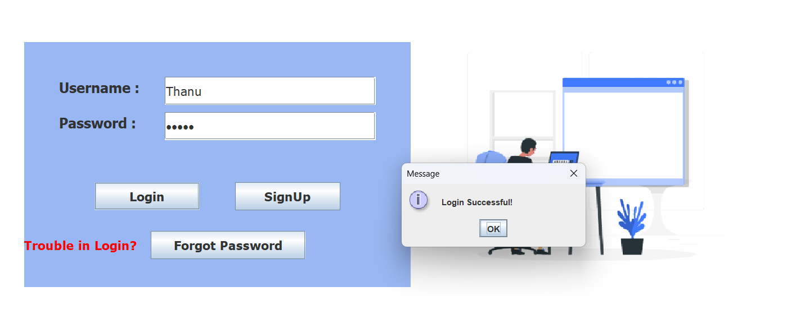
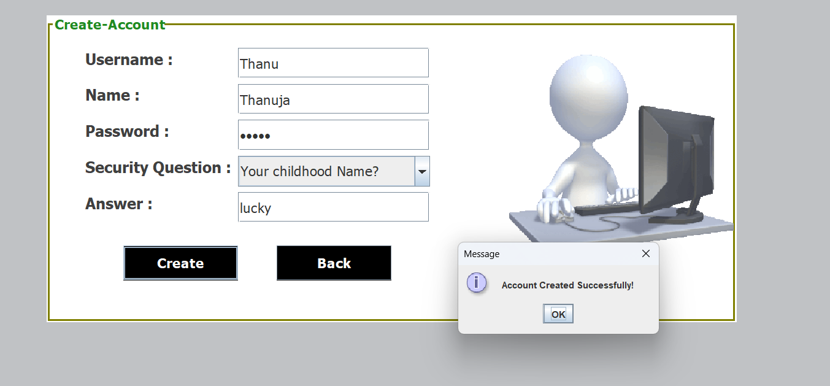
Open page
Sign in
Login page

Slide 7
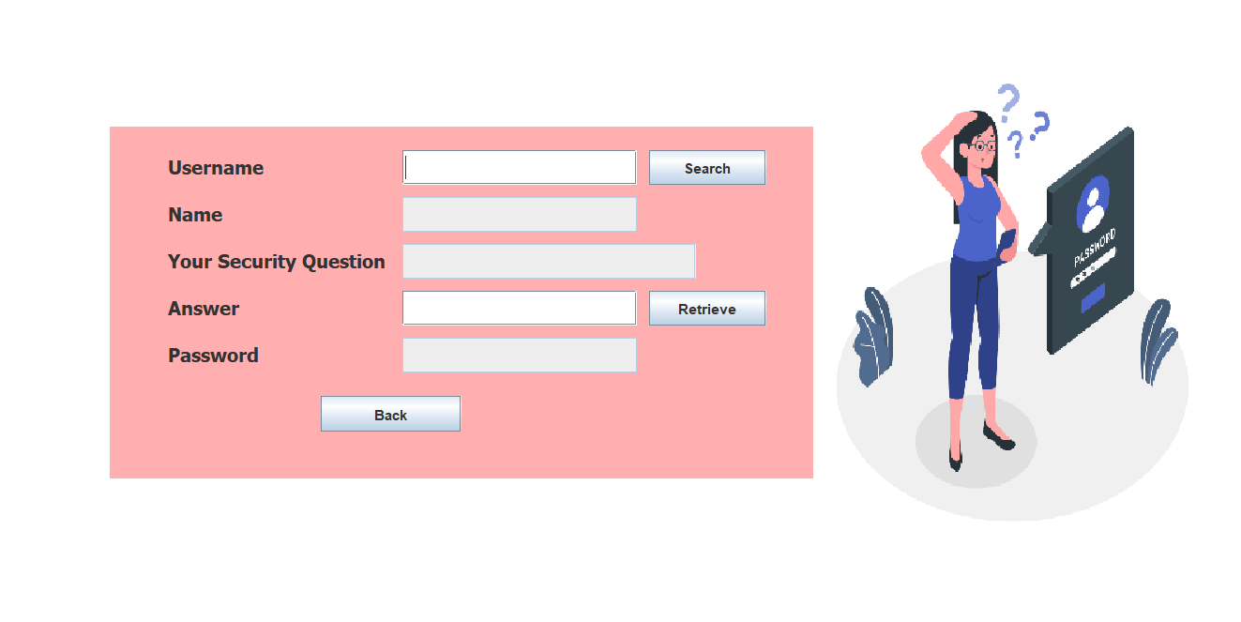
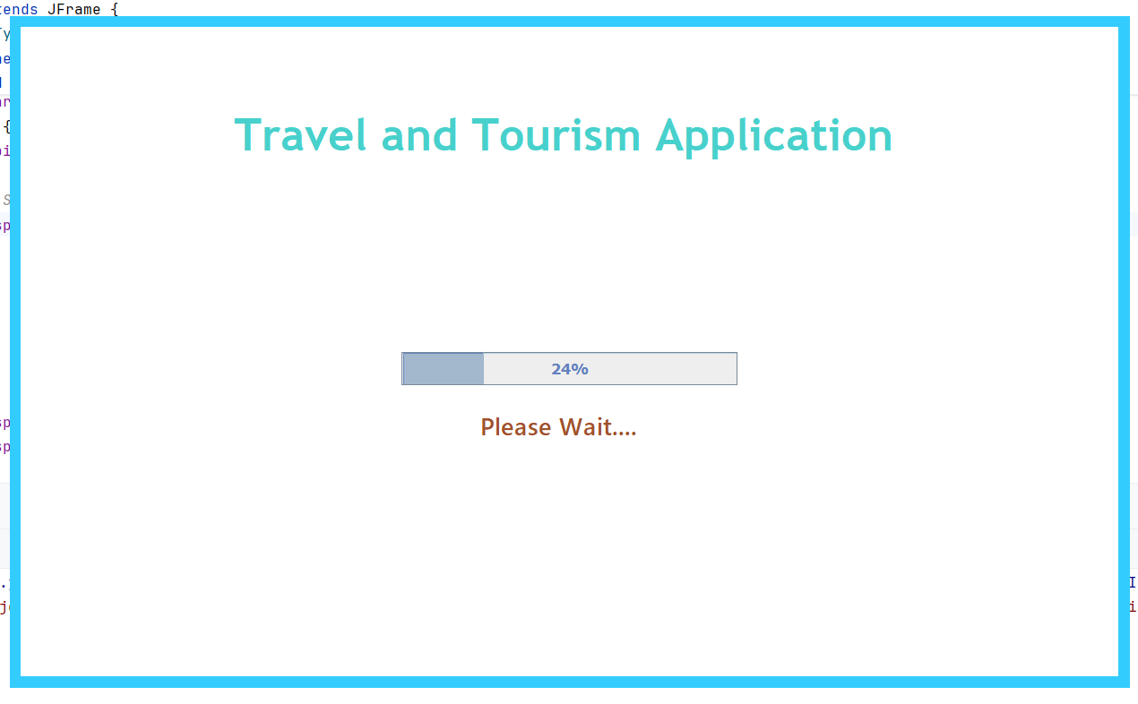
Forgot Password
Loading page

Slide 8
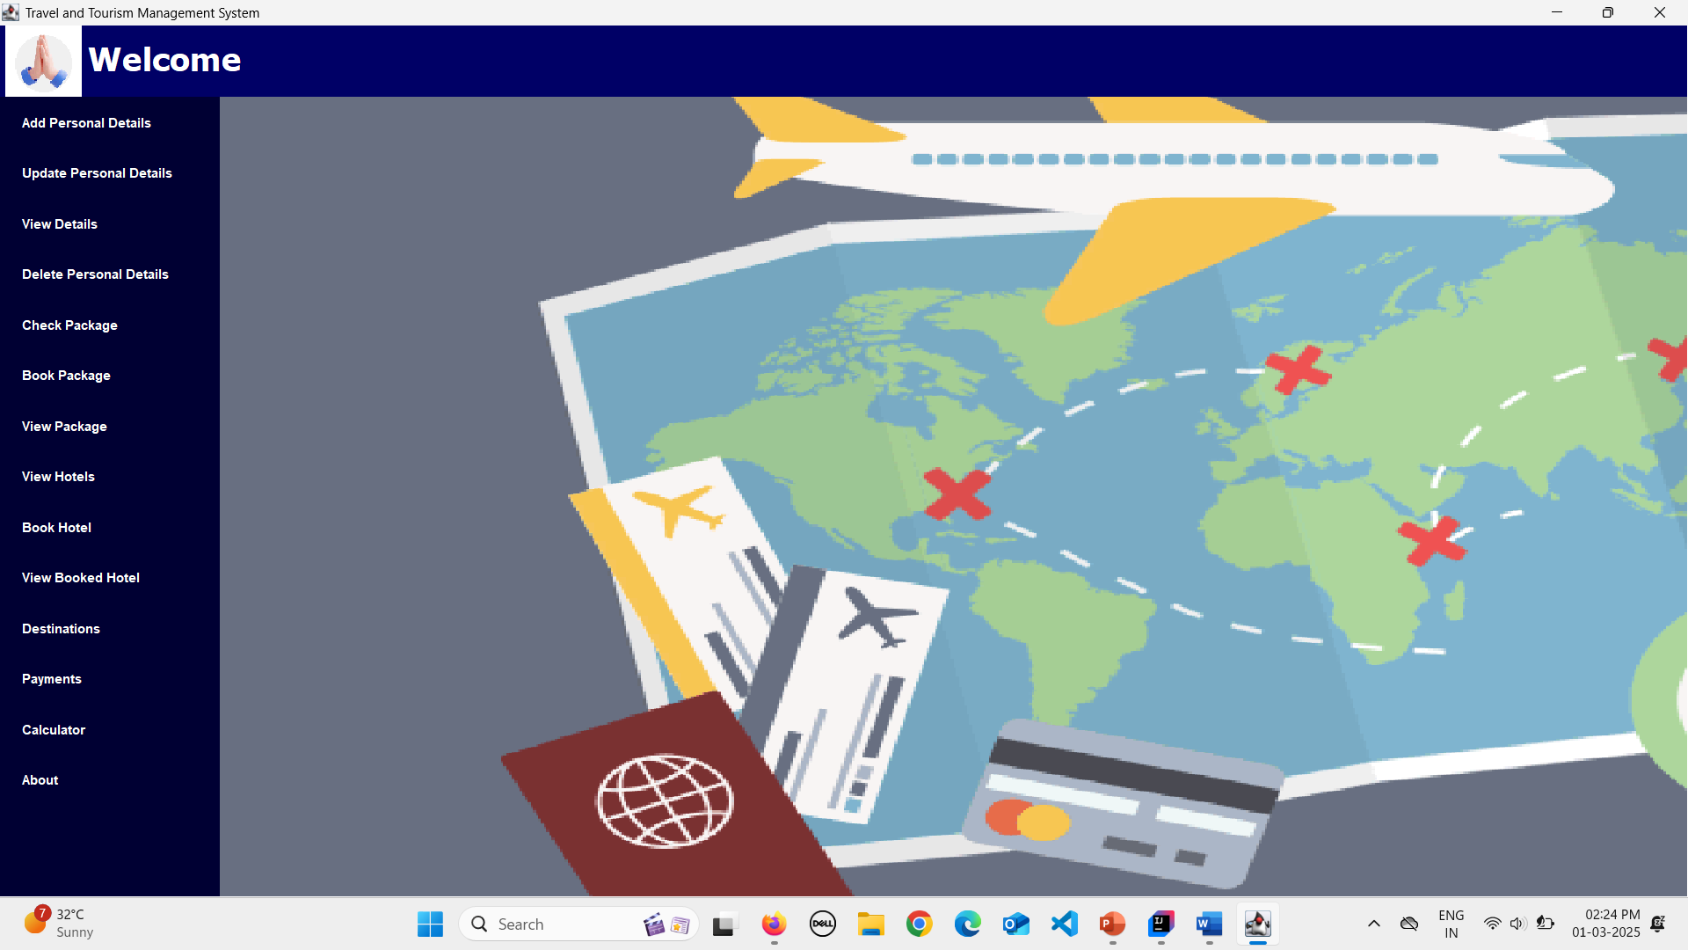

Slide 9
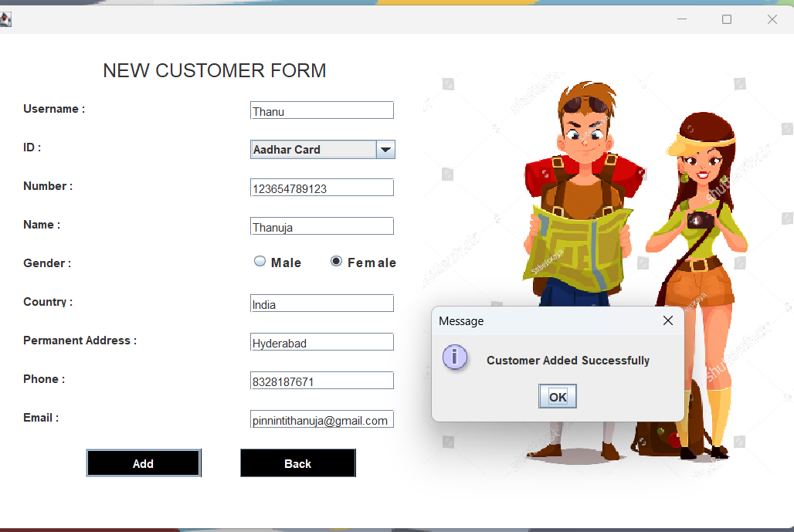
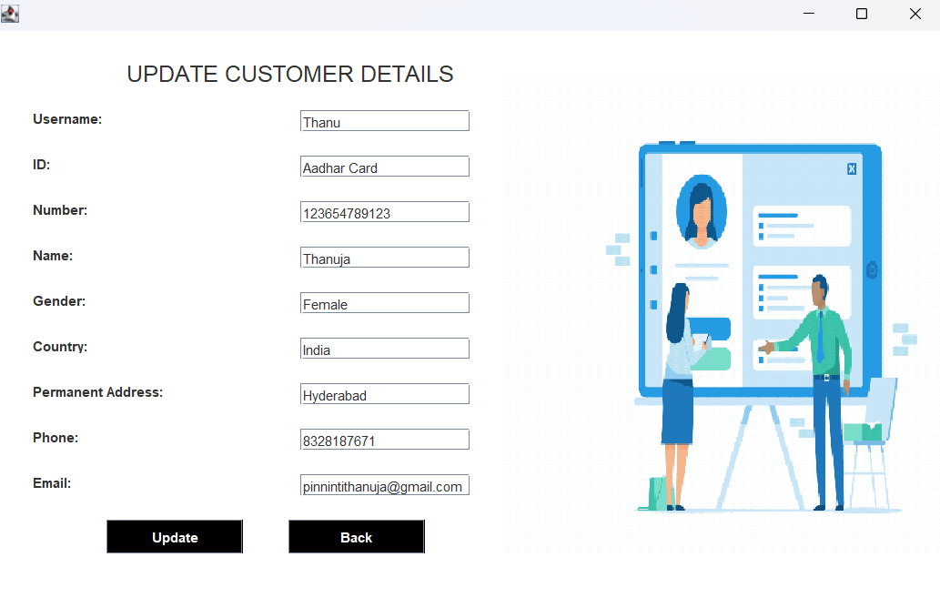

Slide 10
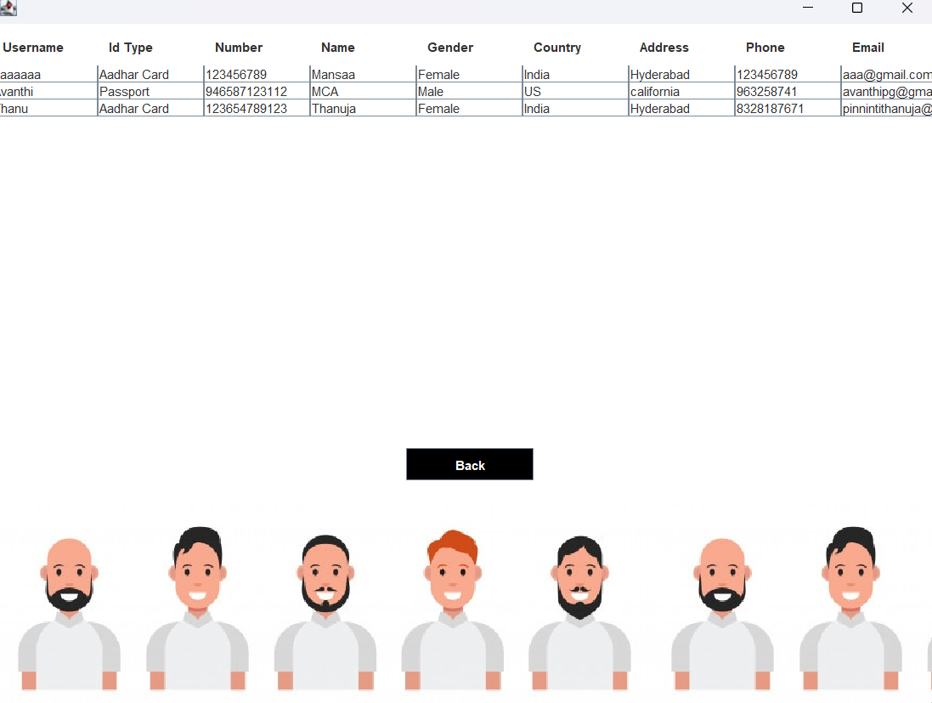
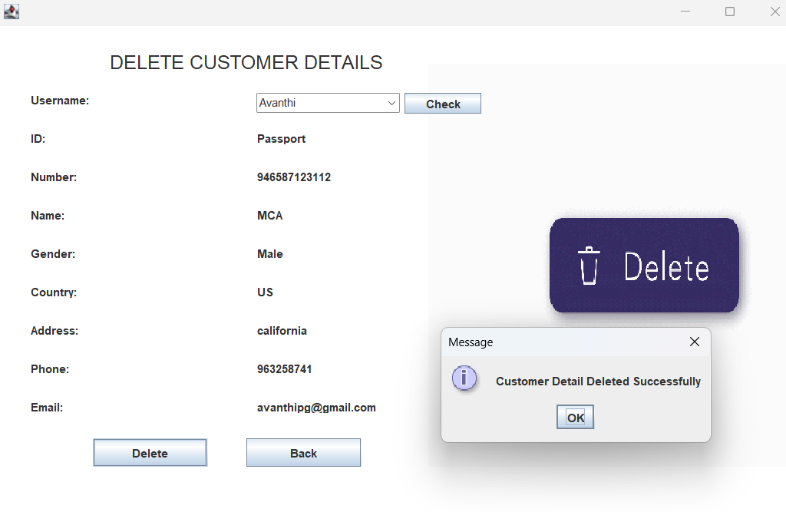

Slide 11
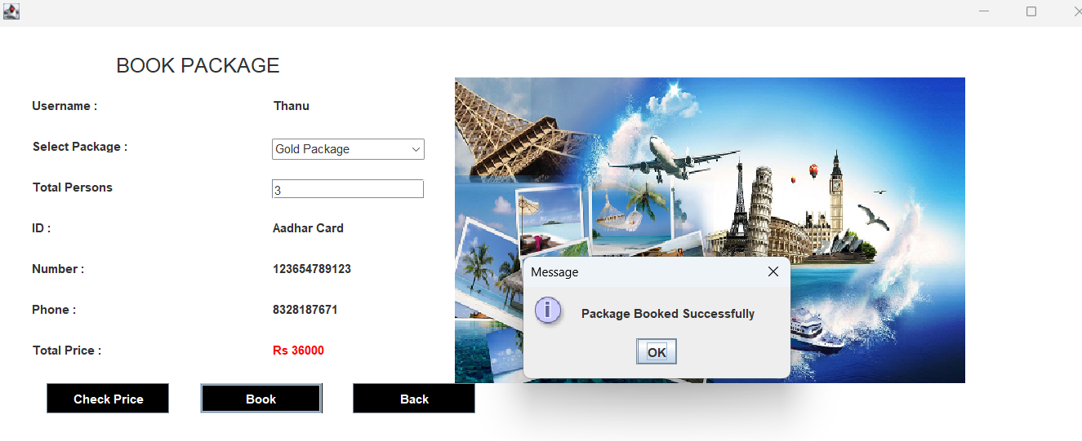
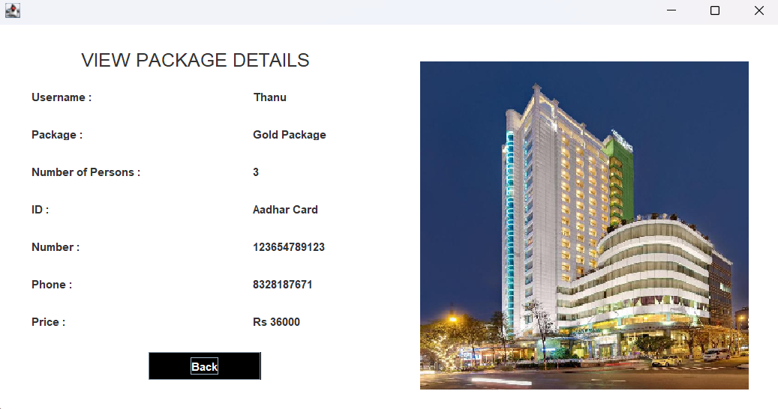

Slide 12
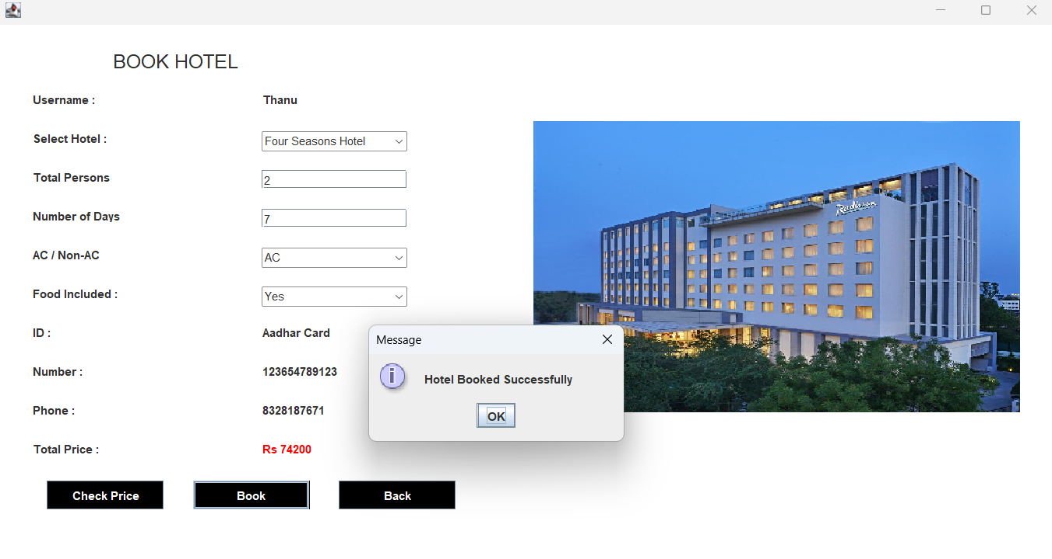
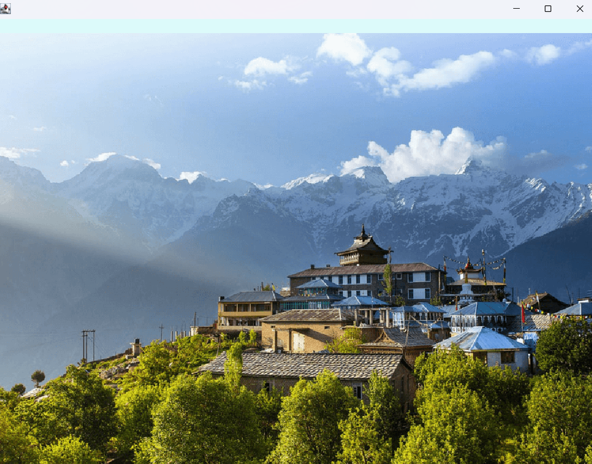

Slide 13
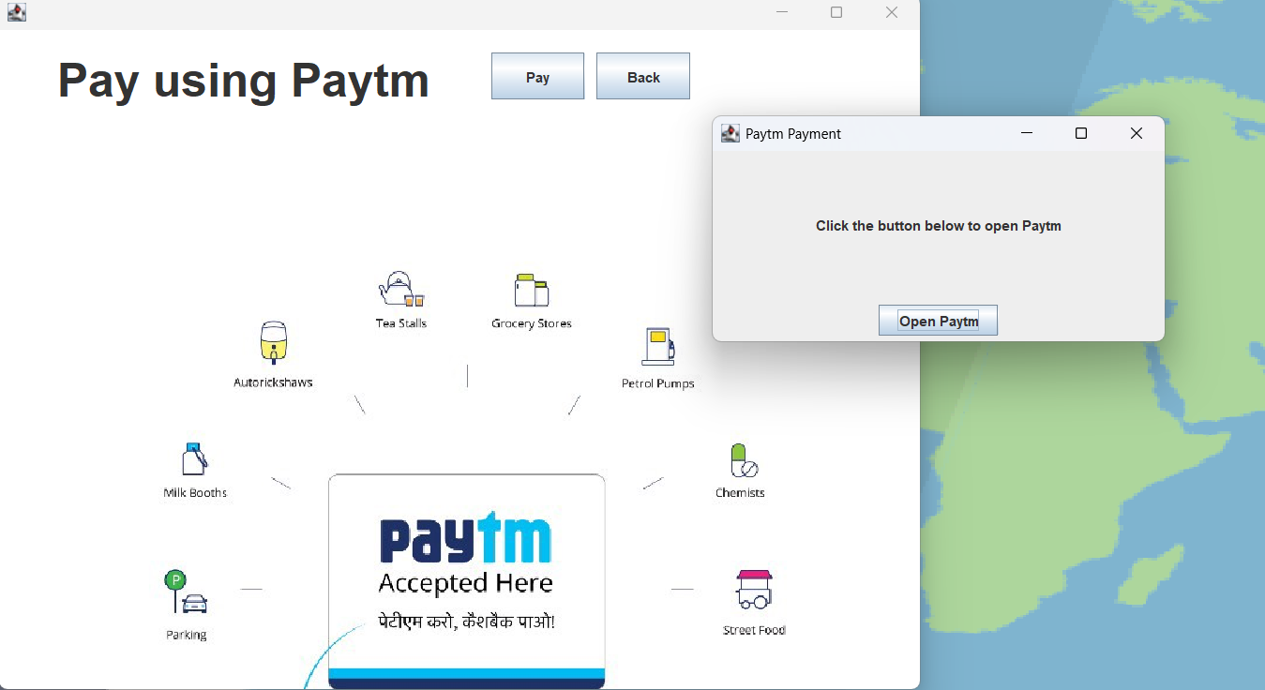
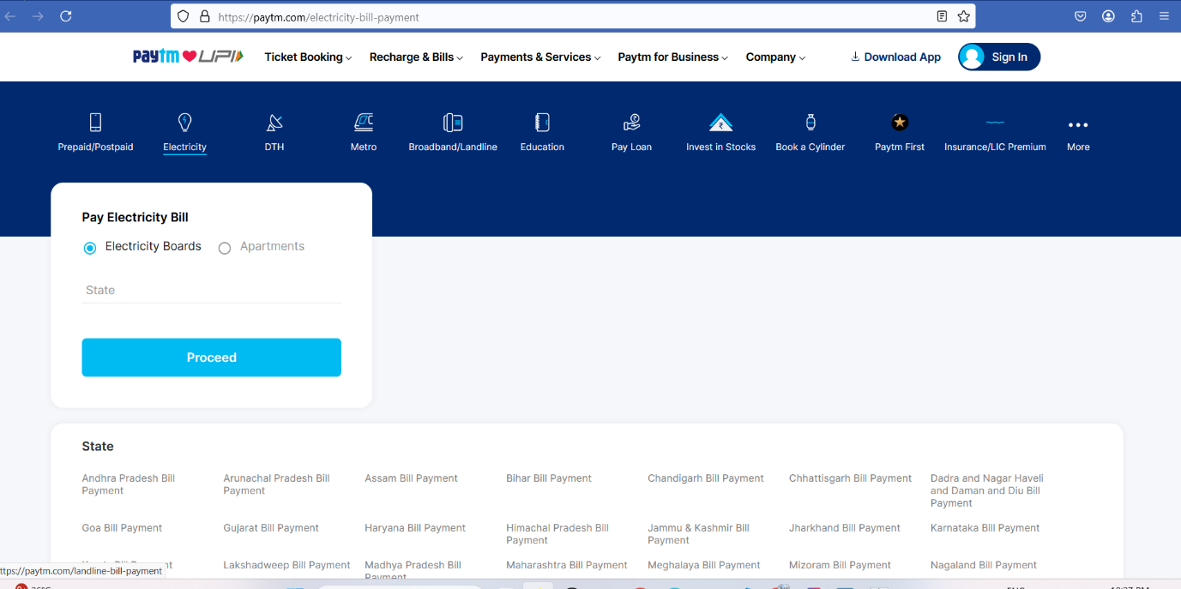

Slide 14
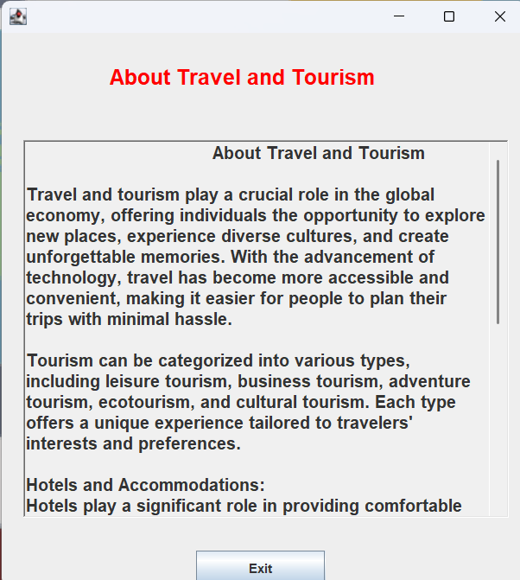
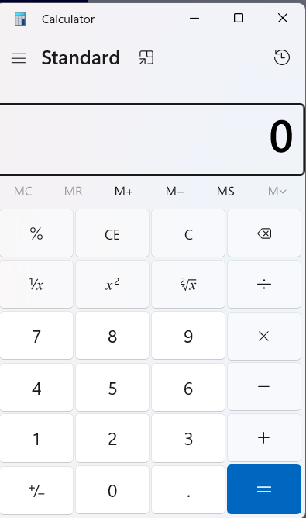

Slide 15
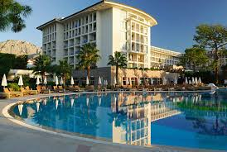





4.Database Schema
Definition: A database schema represents the logical structure of the system’s database.
Entities:
Users (Accounts, Customers)
Booking Details (Hotels & Packages)
Payment Transactions
Relationships: Shows how tables are connected.

Slide 16

Customer Management
Overview: Stores and manages customer-related information.
Database Fields: Name, contact details, address, email, etc.
Functions:
Add new customers.
Update customer details.
Retrieve customer information.
Login & Registration Module
Features:
User authentication with a secure login system.
Registration process with input validation.
Storing user credentials securely in the database.
Home Page & Navigation
Purpose: Provides an intuitive interface for users to explore services.
Features:
Easy navigation to different modules.
Links to package details, customer profile, and payment options.
Package Management
Overview: Enables users to browse and book tour packages.
Functions:
List available packages.
Add or update package details.
Assign prices and discounts.

Slide 17

Booking Hotels & Packages
Purpose: Allows customers to book accommodations and travel packages.
Database Fields: Username, hotel name, package type, number of persons, price, etc.
Booking Features:
Availability check.
Dynamic price calculation based on days/persons.
Confirmation messages on successful booking.
Payment Integration (Paytm API)
Overview: Secure online payment gateway integration.
Features:
Customers can pay via Paytm.
Secure transaction handling.
Order confirmation on successful payment.

Slide 18
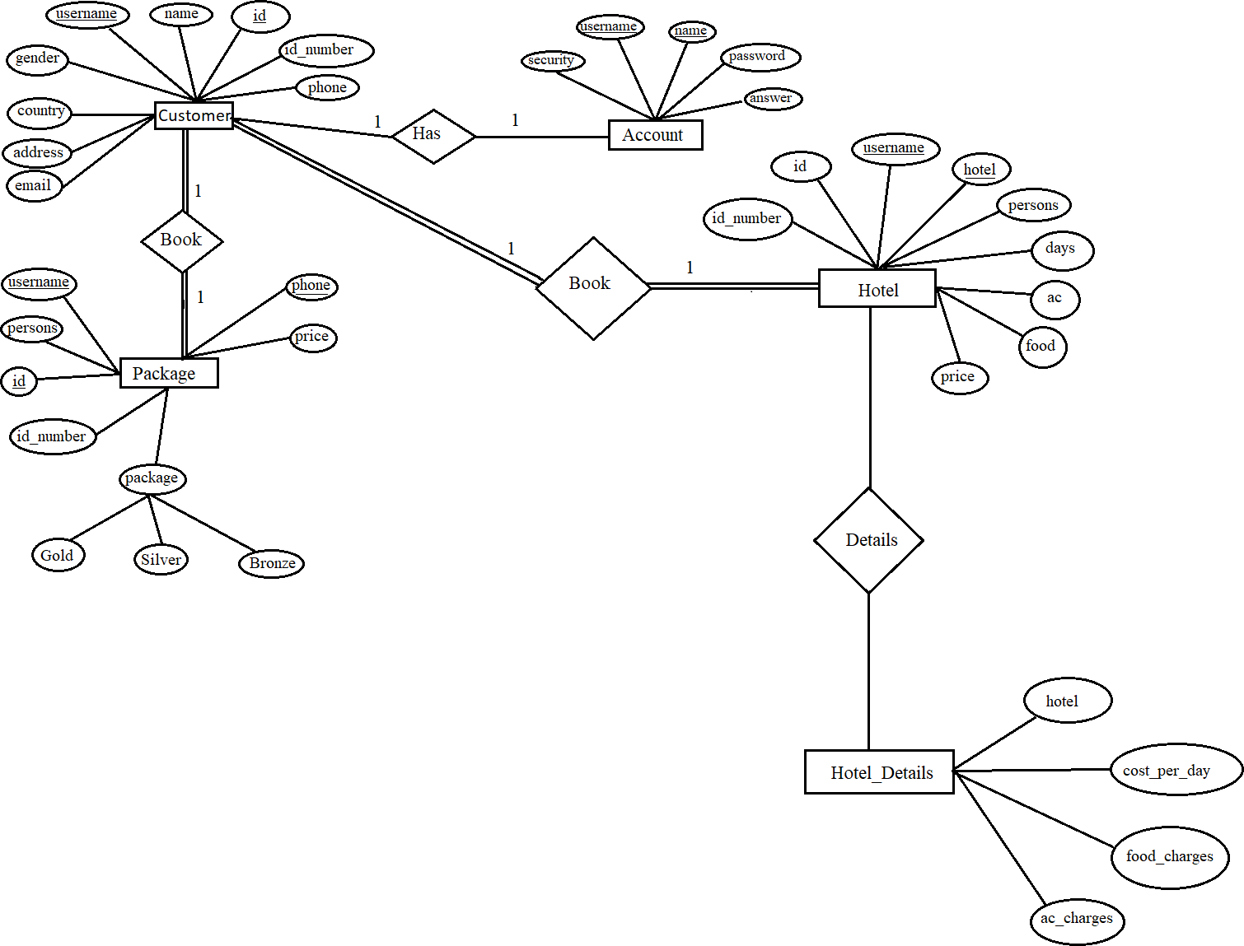
ER Diagram

Slide 19

Testing Process & Test Case Results
Testing Approach: Functional testing to verify the system’s reliability.
Test Cases:
Login Validation: Checks incorrect username/password handling.
Data Insertion: Ensures mandatory fields are filled.
Booking Confirmation: Verifies successful reservations.
Payment Processing: Checks Paytm API integration.
Results: All test cases passed successfully.

Slide 20

Conclusion
The Tourism Management System simplifies the process of managing trips, hotel bookings, and customer records.
Key benefits include:
User-Friendly Interface – Easy booking and data management.
Automation – Reduces manual work and increases accuracy.
Secure Database Management – Ensures customer data is stored safely.
Overall, this system helps tourists and travel agencies manage trips efficiently.

Slide 21
Future Enhancements
To further improve the system, we plan to add:
AI-powered recommendations – Personalized package suggestions.
Mobile application – Expanding accessibility on smartphones.
Integration with payment gateways – Secure online payments.
Real-time location tracking – Live updates for travelers.
These enhancements will make the system more advanced and user-friendly.

Slide 22


Slide 23

Thank you

